Slide 1



Custom Pega Training for Ministry of Justice
Entry Level – 3 Day App Build

Slide 2


Day 3
Pega Inception to app build in a day

Slide 3


Day 3- Agenda & Introductions
Time | Topics
9:30 AM to 10:30 AM | DATA TYPES
10:30 AM – 11:30 AM | REPORTS
11:30 AM – 12:30 PM | CORRESPONDENCE
12:30 PM – 1:30 PM | LUNCH BREAK
1:30 PM – 3:00 PM | INTRODUCTION TO INTEGRATION IN PEGA APPLICATIONS
3:00 PM – 3:30 PM | COFFEE BREAK
3:30 PM – 5:30 PM | EXERCISE AND PRODUCT RULE
5:30PM – 6:00PM | Q&A

Slide 4
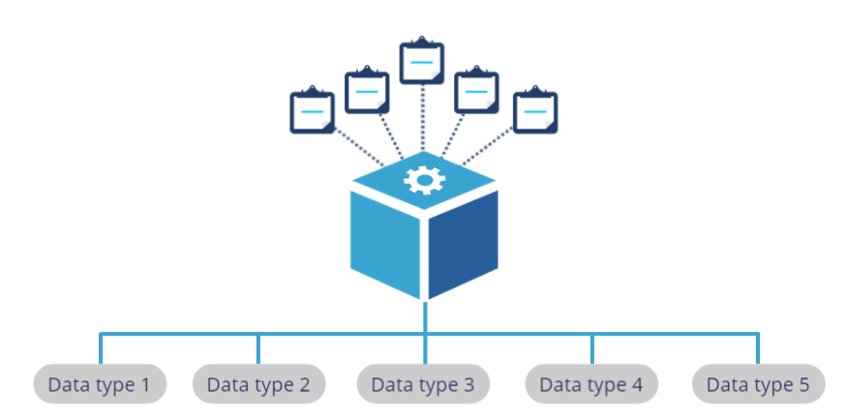
9:30 AM – 10:30 AM
Data Types
Pega application collects, consume and process data that is important to a case. Data types uniquely define and hold data for your application.
In simple words, Data type is just a class type which contains data instances.

Slide 5
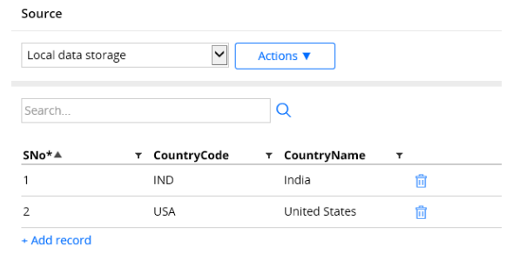
What is a Data type
It is a data layer for an application.
This data layer contains data instances specific to particular type.
Imagine a call center organization. We are customers to that organizations.
Now think and say “What can be the primary data type for that application?” Yes, Customers.
Now In this case I can have a data type as customers. I can have new properties, separate table and data pages to access.

Slide 6

10:30AM – 11:30AM
REPORTS DEFINITION IN PEGA

Slide 7

Report Definition
Report definition is a User-friendly version of connect-sql rule.
Note: Report Definition can only be used to browse the record from the database table. It can not be used to alter / update / delete the records.
Where can we refer a Report Definition rule?
Data Page - as a source to Fetch multiple results (page list)
Used in many UI Control - repeating grid, List, autocomplete
Called from Activity: Rule-obj-reportdefinition.pxRetreieveReportData
What is Report Definition rule?
A report Definition Rule Generates SQL Query to retrieve data rom the database tale and can generate HTML to display the result.
Report definition supports chart and can be used in dashboard reports.
report definition can retrieve data from two or more tables.
Report definition support parameter and can be rendered dynamically

Slide 8
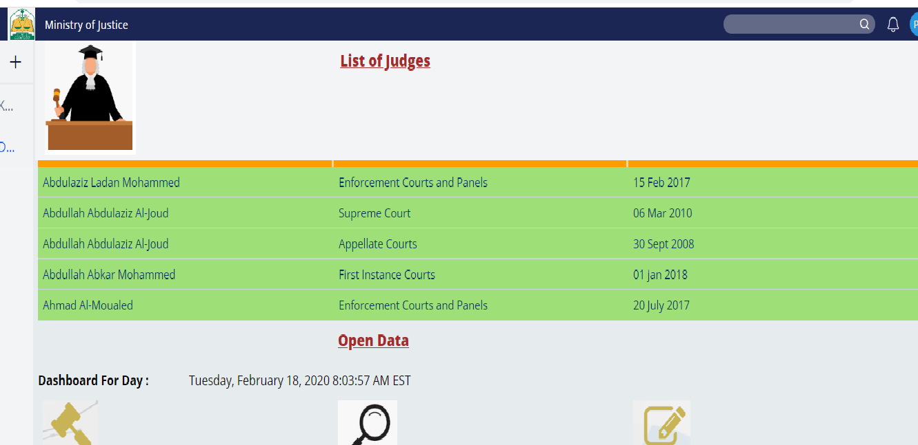

User Portal
Applications often support multiple types of users, such as case workers and managers.
Each type of user interacts with the application in a unique manner. For example, case workers create and process cases, while managers track the progress of cases.
Each type of user needs access to tools and features that support their role in case processing.

Slide 9
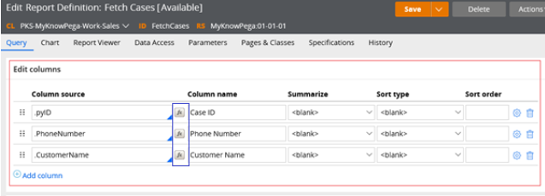
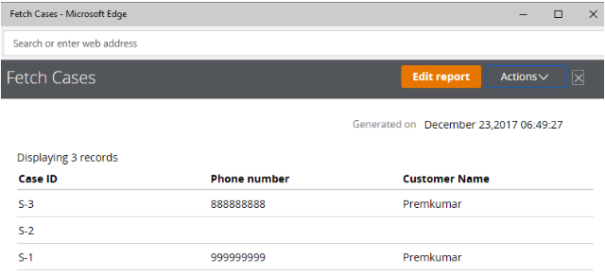
Report Definition

Slide 10

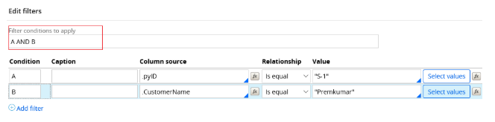
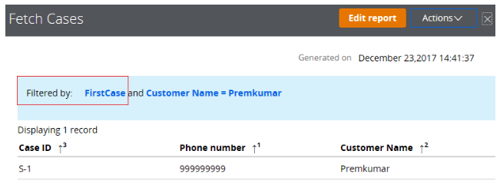
Filter Condition in Reports

Slide 11

11:30AM – 12:30PM
CORRESPONDENCE IN PEGA

Slide 12
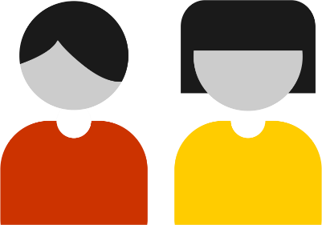



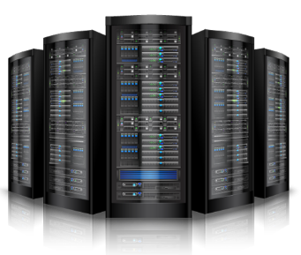
Correspondence
Scenario: You need to send am email from your personal Gmail ID to your friend who use a yahoo ID
Aisha@outlook.com
Abbas@outlook.com
Sender Mail Client
Receiver Mail Client

Slide 13
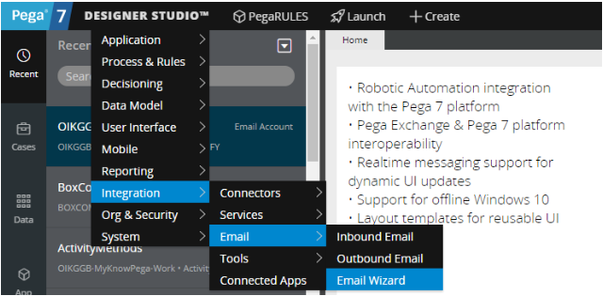
What is an Email Account?
Email Account is an data instance.
It belongs to integrator resource category.
Email account instance holds the account details both for outbound (outgoing and inbound (incoming) email.
Configuring an Email Account
Pega provides a simple wizard to configure an Email account.
Designer Studio → Integration → Email → Email Wizard

Slide 14
12:30AM – 1:30PM LUNCH BREAK

Slide 15
1:30AM – 3:00PM Introduction to Integration in Pega Applications

Slide 16
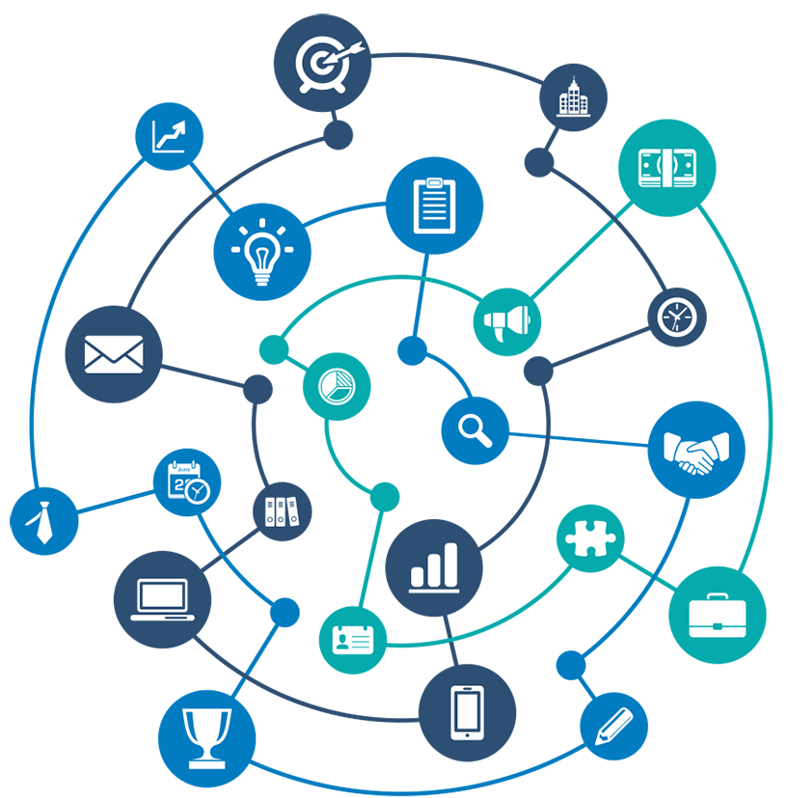
Introduction to Integration
Most businesses have applications that handle a wide variety of business needs. Many of these applications need to exchange data with each other as well as with external systems.
Integration enables your application to exchange data with other systems.
For example, your application might need to access data or computations provided by an external system or respond to requests from external systems.

Slide 17
CONNECTORS
Imagine the process of applying for a loan. First, a customer completes a loan application and submits the application to the bank.
The bank enters the customer’s information into the application system.
The bank then verifies the customer's credit score with a credit agency.
The bank application must integrate with the credit agency system to verify the credit score.
In this example, the application requests data from another system. Pega uses Connectors to facilitate this type of integration.
You can invoke Connectors from data pages and activities.
Supported Connectors:
Pega provides connectors for a wide range of industry-standard protocols and standards. Standard connectors include SOAP, REST, SAP, EJB, JMS, MQ, File, and CMIS.

Slide 18
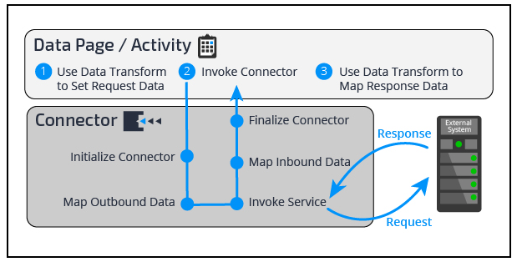
How Connectors exchange data

Slide 19
Services
To get a 360-degree view of a customer, you must gather information for that customer from several different systems. One of those systems could be a Pega Platform
For example, if an insurance claim application is implemented on the Pega Platform, you may need to expose a service that returns the claims for a specific customer.
In this example, an external system requests data from your application. Pega uses services to facilitate this integration.
Services allow you to expose the data and functionality of your application to external systems.
Supported Connectors:
Pega provides services for a wide range of industry-standard protocols and standards, including SOAP, REST, EJB, JMS, MQ, and File.

Slide 20
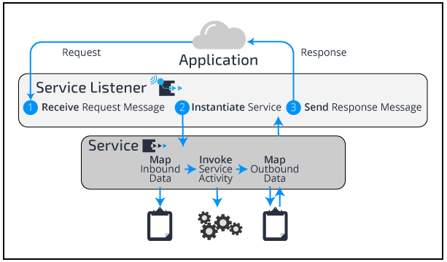
How Services exchange data

Slide 21
3:00 PM – 3:30 PM COFFEE BREAK

Slide 22
3:30PM – 5:30PM EXERCISE AND PRODUCT RULE

Slide 23
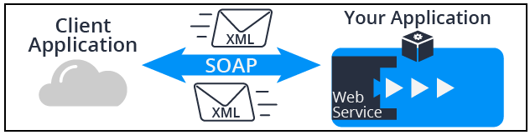
Create a SOAP Service
When you have a requirement to implement a SOAP web service to expose your application to other applications, you do this by creating a service.
SOAP web services communicate using the SOAP protocol and pass XML messages from one application to another.
Your application needs to convert that XML message to Pega objects to process them and then convert those Pega objects back to XML after the processing is complete.

Slide 24
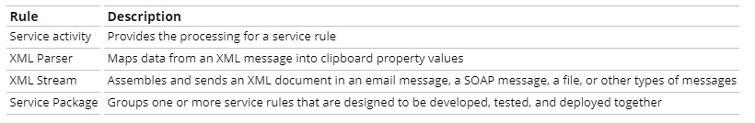
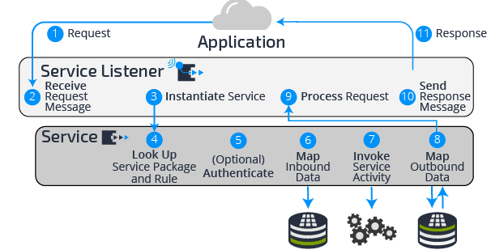
A SOAP service uses a combination of rules to process a request. The rules you use are:
These rules work together to process a request and send a response back to another application. The following diagram shows how Pega processes a service request.

Slide 25
Creating a SOAP service using the Service Wizard
You run the Service Wizard to create all the records needed to expose your application as a service.
The Service Wizard walks you through entering the settings required to create the service.
The Service Wizard does not create XML mappings for inherited properties, so you must add those properties as needed.
In Dev Studio, select Configure > Integration > Services > Service Wizard to start the Service Wizard.

Slide 26
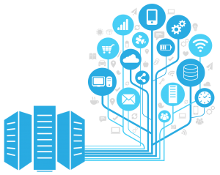
Introduction to Migrating an Application
Applications consist of rulesets, application data, system data, and other objects such as database schemas. As an application moves toward production, the application and its components must migrate among Pega systems.
For example, after you have completed development, you migrate the application from the development environment to a QA environment.
In some cases, you may want to migrate only specific application components such as updated rulesets or data objects included in a patch release.
Like the manifest described in the previous example, you create a ”Product Rule” that identifies the application components you want to move to a destination Pega system.

Slide 27
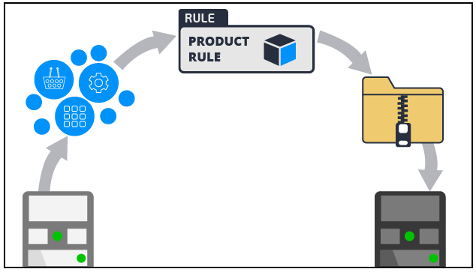
Introduction to Migrating an Application
To create an application archive file, you must first create a product rule to identify the components you want to include in the archive file. Then, you create an archive file that contains the application components.

Slide 28
5:30PM – 6:00PM Q&A

Slide 29
Thank you
Any Questions?

